Slide 1
Housing Price Prediction
In this task we need to perform EDA & model building to observe which factors is affecting the sale price of house & how much that factor is affecting the sale price. Also we need to observe that whether it would be good to buy the property on the price it is enlisted or not.

Slide 2
Steps taken before EDA was performed
Imported necessary libraries for task to be completed.
Loaded dataset on jupyter notebook using pandas library.
By looking at the columns of dataset, identified the target column (SalePrice) to make prediction.
Checked dimension of the dataset which was showing that train dataset contains 1168 rows & 81 columns & test dataset contains 292 rows & 80 columns.
Checked description of dataset which gives information of mean, min value, max value, etc of every column in dataset which contains continuous data in it.
Checked the presence of null values in the dataset & null values were present in it.

Slide 3
Exploratory Data Analysis

Slide 4
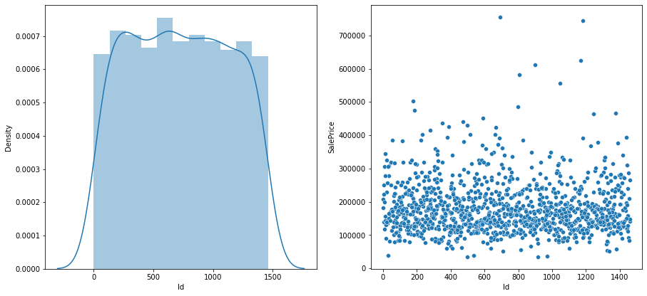
1. Id
Checked unique values of the column.
There was no null value present in the column.
From visualization we conclude that could not determine the skewness of data with data having highest density at 600 & we could not determine the correlation of the data with target column (SalePrice) as data is scattered all over the place.

Slide 5
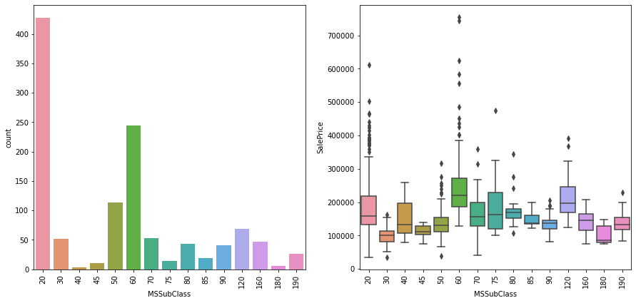
2. MSSubClass
Checked unique values of the column.
There was no null value present in the column.
From visualization we concluded that most data is present in category 20 of MSSubClass & outliers are present in 10 categories of MSSubClass out of total 15 categories of MSSubclass when plotted against SalePrice.

Slide 6
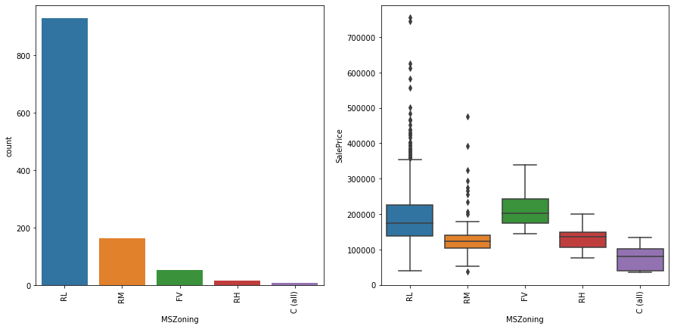
3. MSZoning
Checked unique values of the column.
There was no null value present in the column.
From visualization we concluded that most data is present in RL category & outliers of SalePrice are present in only 2 categories of MSZoning out of total 5 categories.

Slide 7
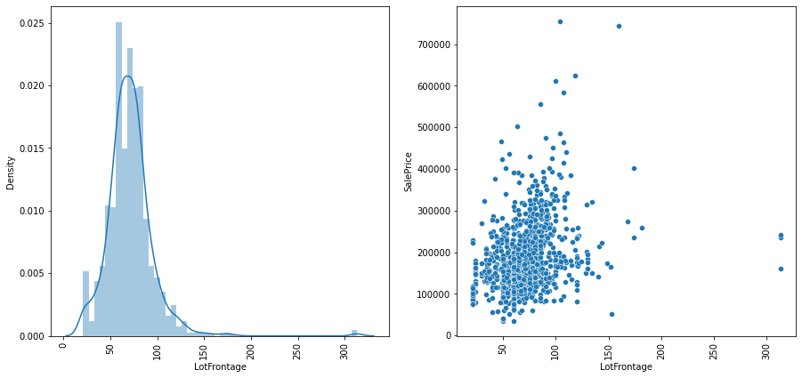
4. LotFrontage
Checked unique values of the column.
Null values were present & filled them randomly to avoid data bias.
From visualization we concluded that data is positively skewed with data having highest density at around 60 & data is showing somewhat positive correlation with SalePrice with data being concentrated mostly under 150 range.

Slide 8
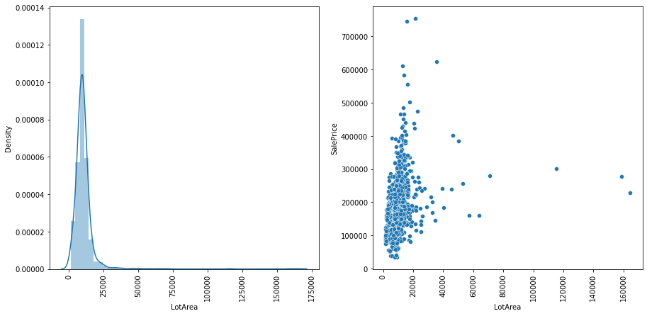
5. LotArea
Checked unique values of the column.
There was no null value present in the column.
From visualization we concluded that data is showing positive skewness with data having highest density at around 2000 & data is showing somewhat positive correlation with SalePrice with data being concentrated mostly under range of 300000 of LotArea.

Slide 9
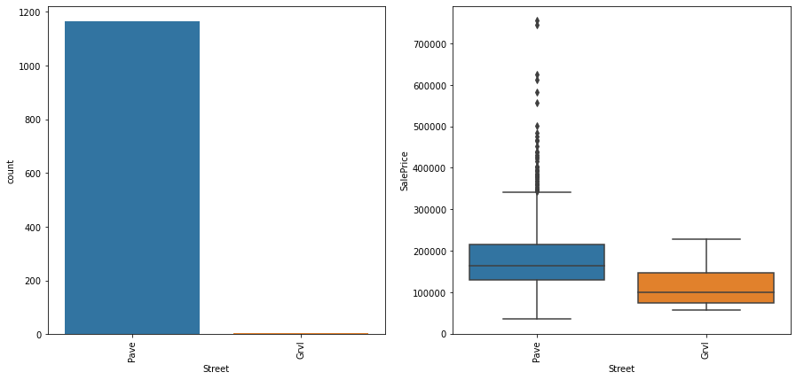
6. Street
Checked unique values of the column.
There was no null value present in the column.
From visualization we concluded that most data is present in pave category & also outliers of SalePrice are present in only pave category of Street.

Slide 10
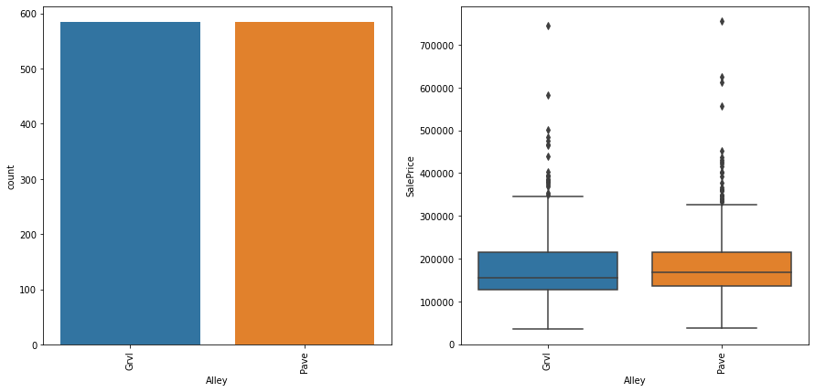
7. Alley
Checked unique values of the column.
Null values were present & filled them randomly to avoid data bias.
From visualization we concluded that data is present equally in both categories & outliers of SalePrice are present in both categories of Alley.

Slide 11
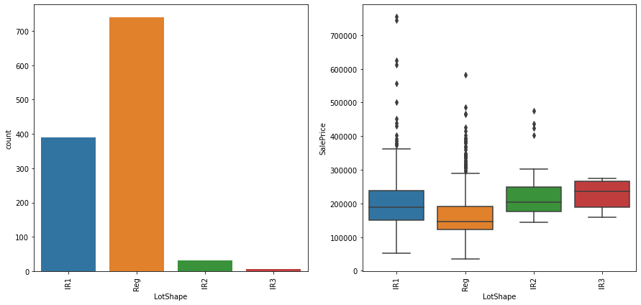
8. LotShape
Checked unique values of the column.
There was no null value present in the column.
From visualization we concluded that most data is present in Reg category of LotShape & outliers of SalePrice are present in 3 categories of LotShape out of total 4 categories of LotShape.

Slide 12
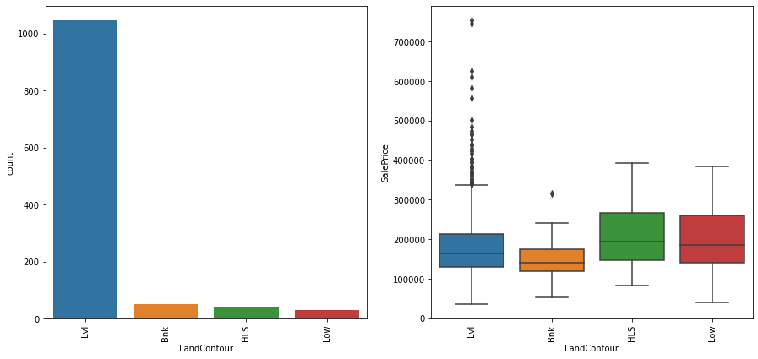
9. LandContour
Checked unique values of the column.
There was no null value present in the column.
From visualization we concluded that most data is present in lvl category of LandContour & outliers of SalePrice are present in 2 categories of LandContour out of total 4 categories of LandContour.

Slide 13
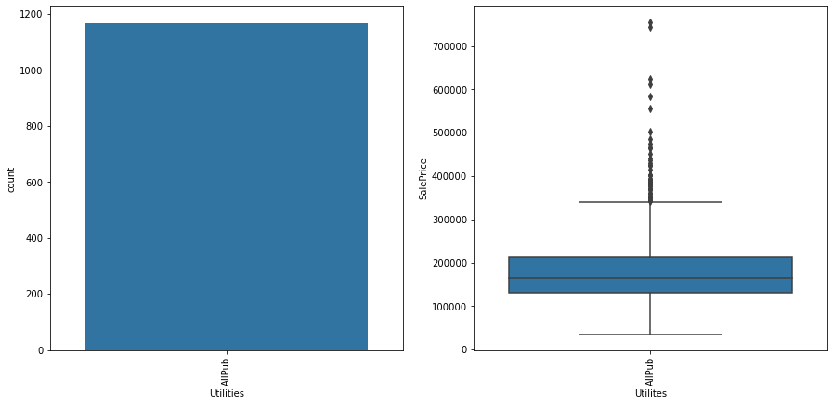
10. Utilities
Checked unique values of the column.
There was no null value present in the column.
From visualization we concluded that only one values is present in every row of whole column & outliers of SalePrice are present in it.

Slide 14
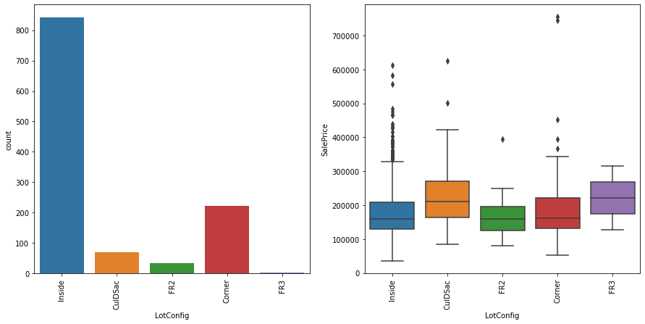
11. LotConfig
Checked unique values of the column.
There was no null value present in the column.
From visualization we concluded that most data is present in Inside category of LotConfig & outliers of SalePrice are present in 4 categories of LotConfig out of total 5 categories of LotConfig.

Slide 15
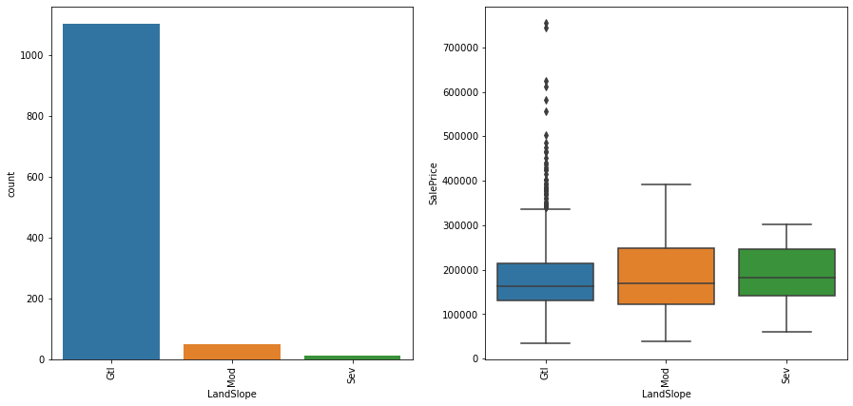
12. LandSlope
Checked unique values of the column.
There was no null value present in the column.
From visualization we concluded that most data is present in Gtl category of LandSlope & outliers of SalePrice is present in only Gtl category of LandSlope out of total 3 categories of LandSlope.

Slide 16
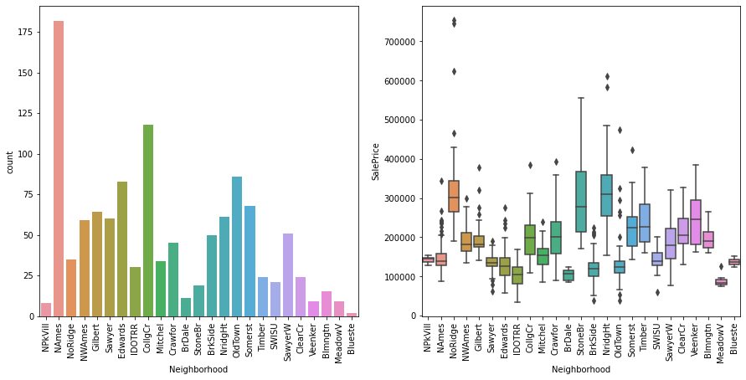
13. Neighborhood
Checked unique values of the column.
There was no null value present in the column.
From visualization we concluded that most data is present in NAmes category of Neighborhood & outliers of SalePrice are present in 14 categories of Neighborhood out of total 25 categories of Neighborhood.

Slide 17
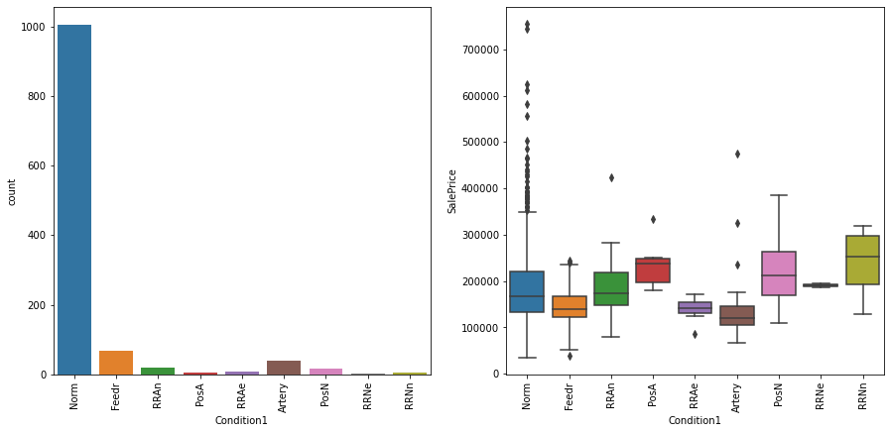
14. Condition1
Checked unique values of the column.
There was no null value present in the column.
From visualization we concluded that most data is present in Norm category of Condition1 & Outliers of SalePrice are present in every category of Condition1 except 1 category.

Slide 18
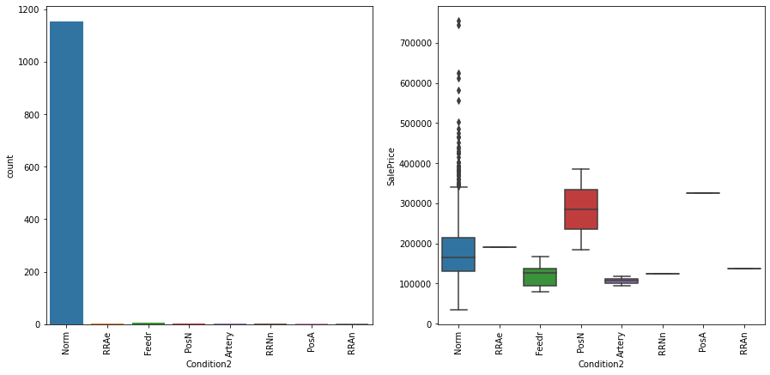
15. Condition2
Checked unique values of the column.
There was no null value present in the column.
From visualization we concluded that most data is present in Norm category of Condition2 & outliers of SalePrice are present in only Norm Category of Condition2 out of total 8 categories of Condition2.

Slide 19
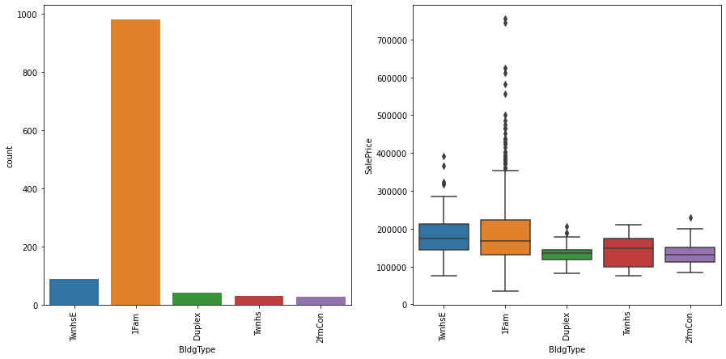
16. BldgType
Checked unique values of the column.
There was no null value present in the column.
From visualization we concluded that most data is present in 1Fam category of BldgType & Outliers of SalePrice are present in every category of BldgType except 1 category which is Twnhs.

Slide 20
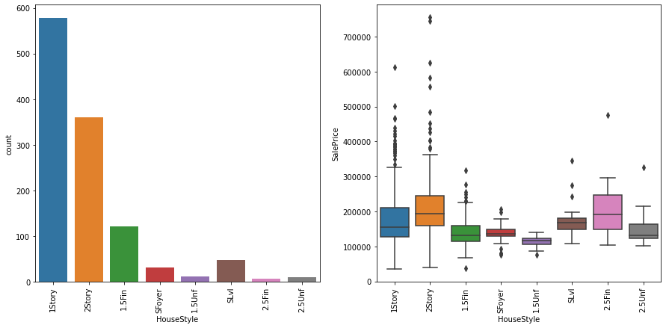
17. HouseStyle
Checked unique values of the column.
There was no null value present in the column.
From visualization we concluded that most data is present in 1Story category of houseStyle & Outliers of SalePrice are present in every category of HouseStyle.

Slide 21
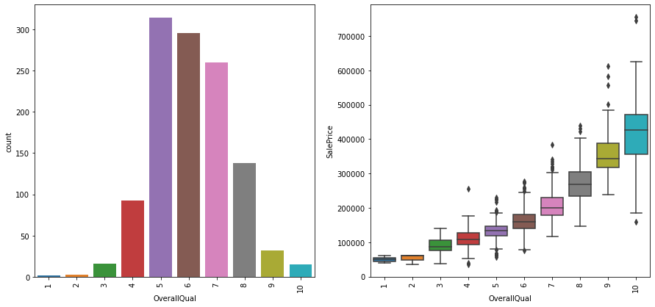
18. OverallQual
Checked unique values of the column.
There was no null value present in the column.
From visualization we concluded that most data is present in category 5 of OverallQual & outliers of SalePrice are present in 7 categories of OverallQual out of total 10 categories of OverallQual.

Slide 22
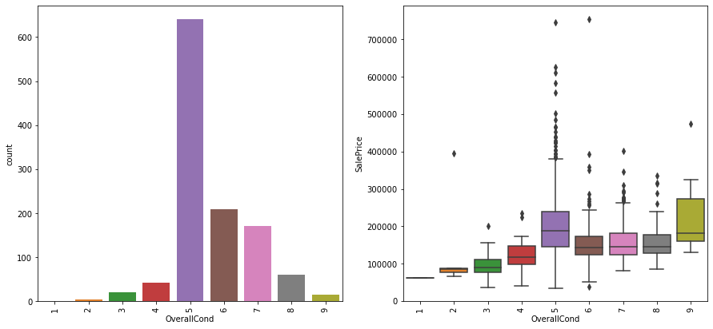
19. OverallCond
Checked unique values of the column.
There was no null value present in the column.
From visualization we concluded that most data is present in category 5 of OverallCond & outliers are present in 8 categories of OverallCond out of total 9 categories of OverallCond.

Slide 23
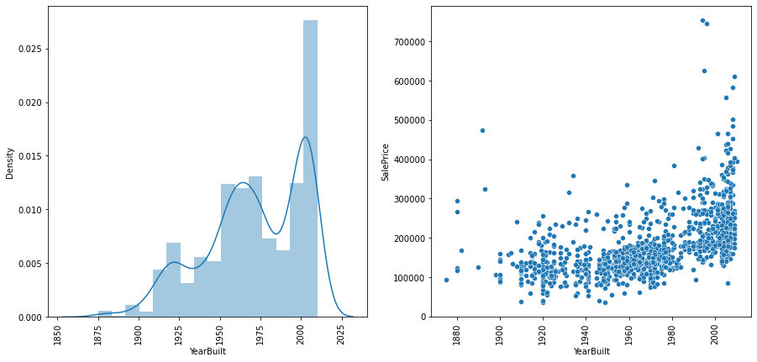
20. YearBuilt
Checked unique values of the column.
There was no null value present in the column.
From visualization we concluded that data is negatively skewed with having highest density at around 2015 & data is somewhat positively correlated with SalePrice.

Slide 24
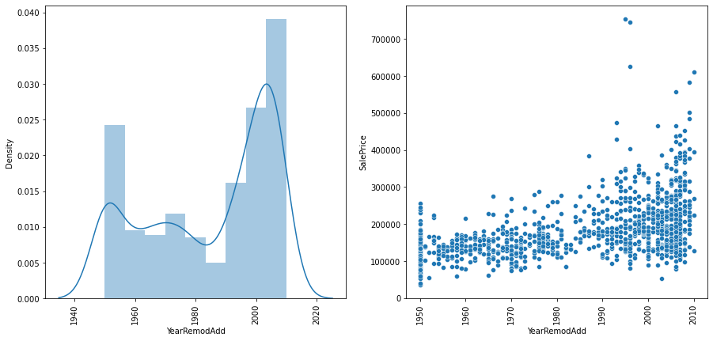
21. YearRemodAdd
Checked unique values of the column.
There was no null value present in the column.
From visualization we concluded that we cannot determine skewness of data with having highest density at around 2010 & data being spread all over the plot equally so correlation cannot be determine with SalePrice.

Slide 25
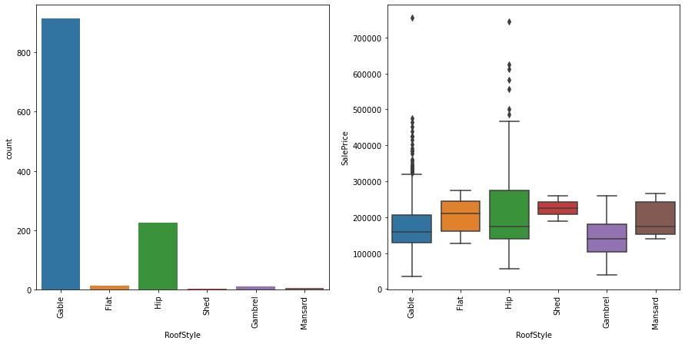
22. RoofStyle
Checked unique values of the column.
There was no null value present in the column.
From visualization we concluded that most data is present in Gable category of RoofStyle & outliers of SalePrice are present in only 2 categories of RoofStyle out of total 6 categories of RoofStyle.

Slide 26
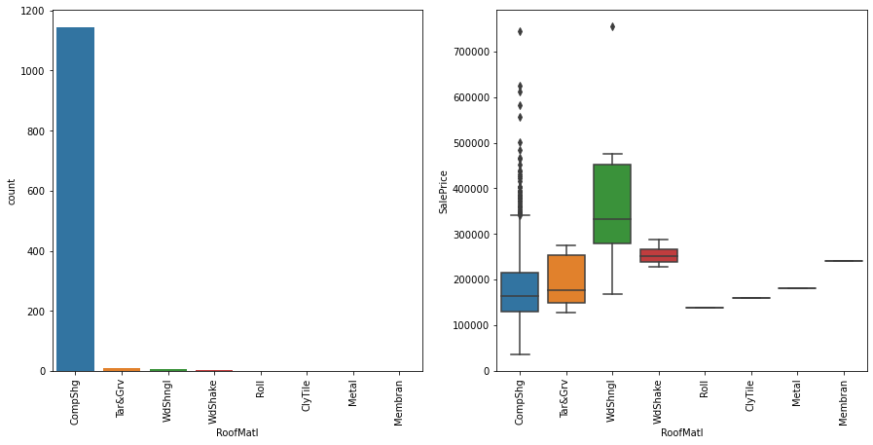
23. RoofMatl
Checked unique values of the column.
There was no null value present in the column.
From visualization we concluded that most data are present in CompShg category of RoofMatl & outliers of SalePrice are present in only 2 categories out of total 8 categories of RoofMatl.

Slide 27
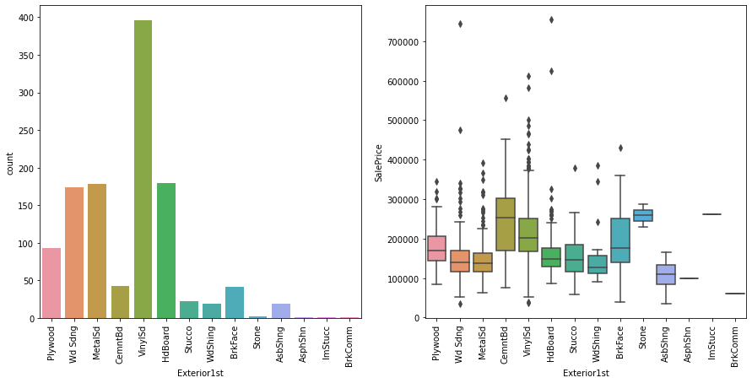
24. Exterior1st
Checked unique values of the column.
There was no null value present in the column.
From visualization we concluded that most data is present in VinylSd category of Exterior1st & outliers of SalePrice are present in 9 categories out of total 14 categories of Exterior1st.

Slide 28
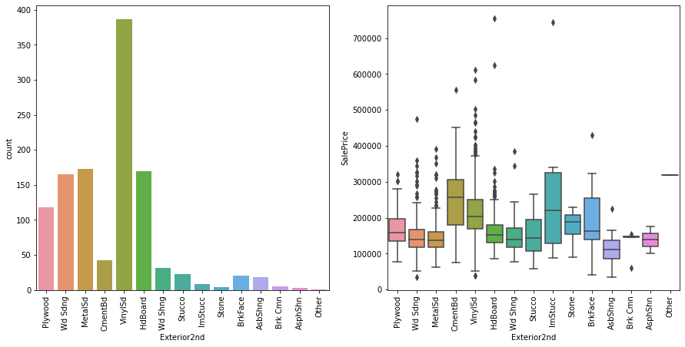
25. Exterior2nd
Checked unique values of the column.
There was no null value present in the column.
From visualization we concluded that most data is present in VinylSd category of Exterior2nd & outliers of SalePrice are present in 11 categories out of total 15 categories of Exterior2nd.

Slide 29
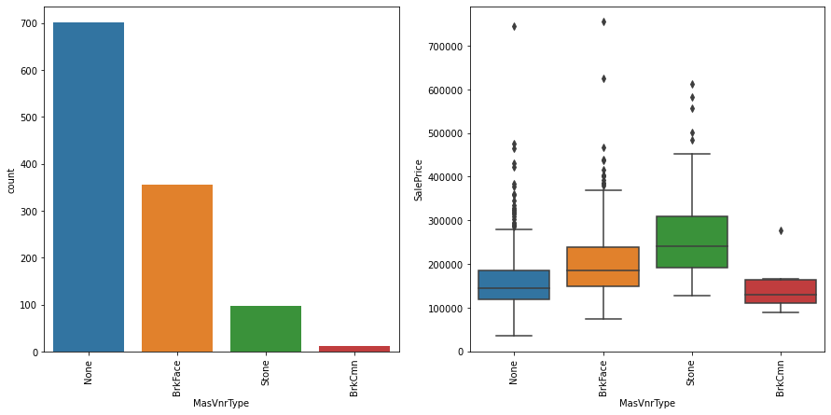
26. MasVnrType
Checked unique values of the column.
Filled the null values randomly to avoid data bias.
From Visualization we concluded that most data is present in None category of MasVnrType & outliers of SalePrice are present in every category of MasVnrType.

Slide 30
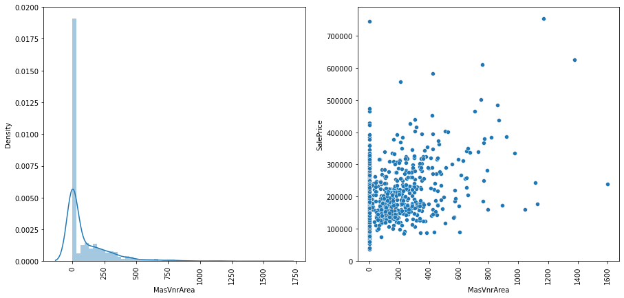
27. MasVnrArea
Checked unique values of the column.
There was no null value present in the column.
From visualization we concluded that data is positively skewed with having highest density at around 0 & data is having positive correlation with SalePrice.

Slide 31
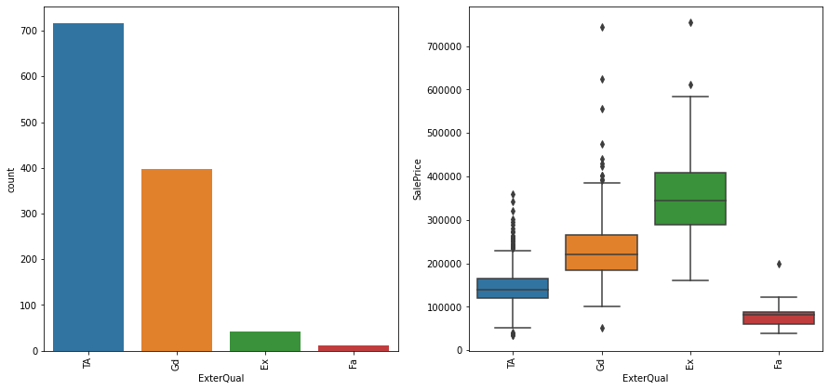
28. ExterQual
Checked unique values of the column.
There was no null value present in the column.
From visualization we concluded that most data is present in TA category of ExterQual & outliers of SalePrice are present in every category of ExterQual.

Slide 32
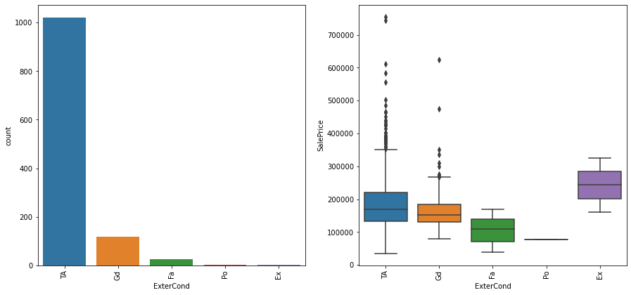
29. ExterCond
Checked unique values of the column.
There was no null value present in the column.
From visualization we concluded that most data is present in TA category of ExterCond & outliers of SalePrice are present in only 2 categories out of total 5 categories of ExterCond.

Slide 33
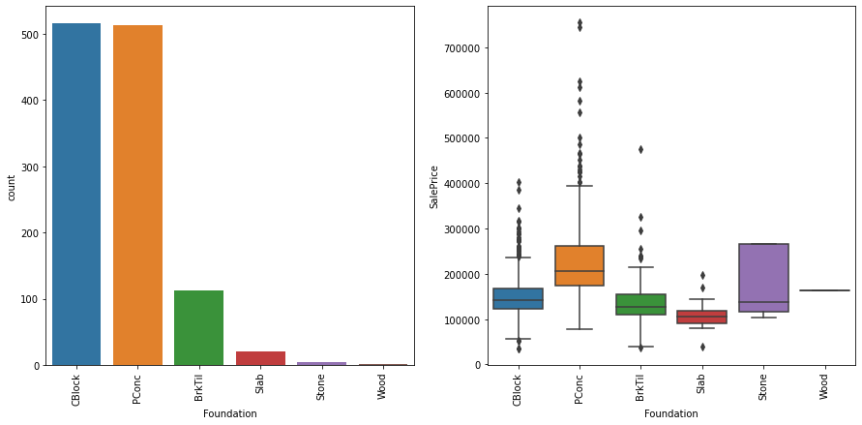
30. Foundation
Checked unique values of the column.
There was no null value present in the column.
From visualization we concluded that most data is present in CBlock category of Foundation & outliers of SalePrice are present in 4 categories out of total 6 categories of Foundation.

Slide 34
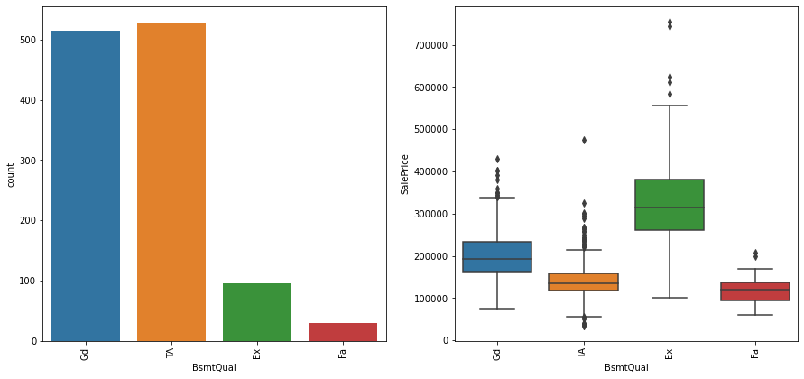
31. BsmtQual
Checked unique values of the column.
Filled null values randomly to avoid data bias.
From visualization we concluded that most data is present TA category of BsmtQual & outliers of SalePrice are present in every category of BsmtQual.

Slide 35
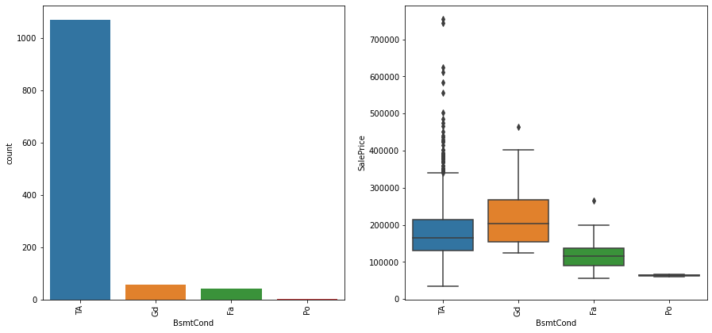
32. BsmtCond
Checked unique values of the column.
Filled null values randomly to avoid data bias.
From visualization we concluded that most data is present in TA category of BsmtCond & outliers of SalePrice are present in 3 categories out of total 4 categories of BsmtCond.

Slide 36
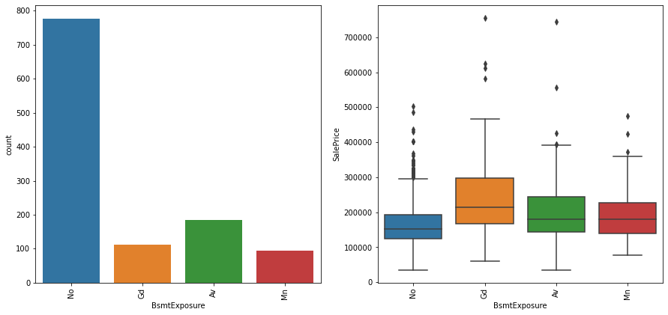
33. BsmtExposure
Checked unique values of the column.
Filled null values randomly to avoid data bias.
From visualization we conclude that most data is present in No category of BsmtExposure & outliers of SalePrice are present in every category of BsmtExposure.

Slide 37
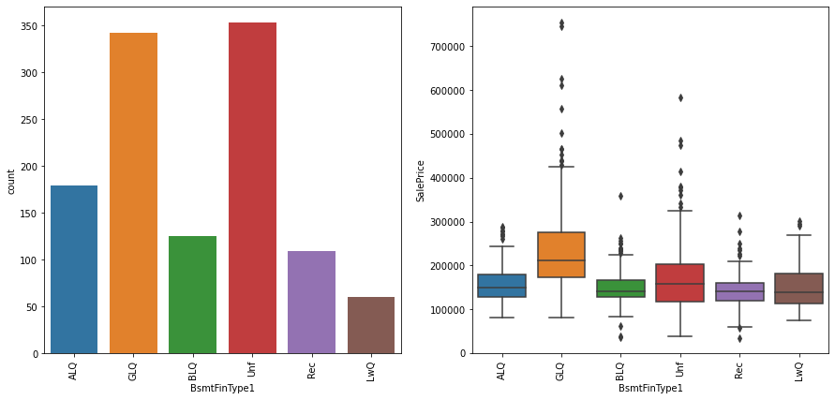
34. BsmtFinType1
Checked unique values of the column.
Filled null values randomly to avoid data bias.
From visualization we concluded that most data is present in Unf category of BsmtFinType1 & outliers are present in every category BsmtFinType1.

Slide 38
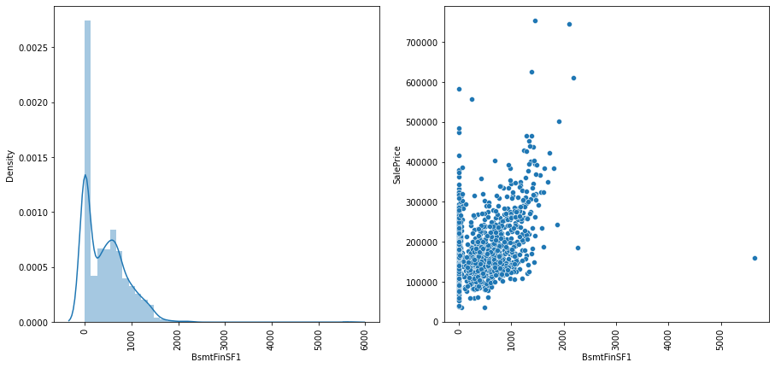
35. BsmtFinSF1
Checked unique values of the column.
There was no null value present in the column.
From visualization we concluded that data is positively skewed with having highest density at around 0 & it is showing positive correlation with SalePrice on plot.

Slide 39
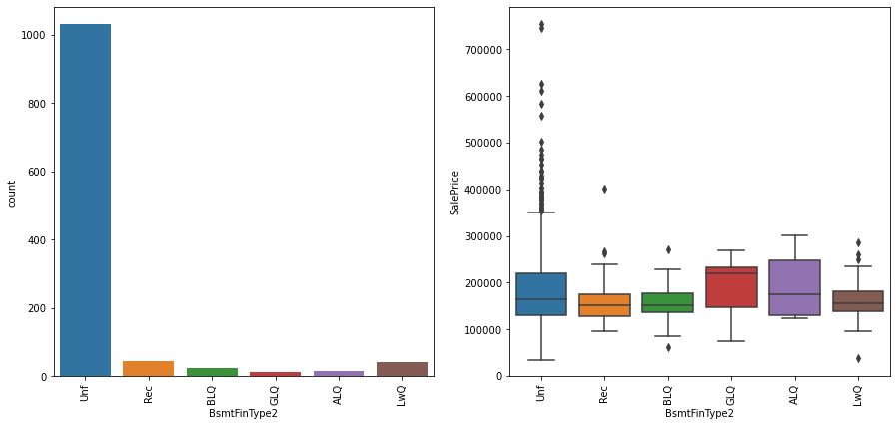
36. BsmtFinType2
Checked unique values of the column.
Filled null values randomly to avoid data bias.
From visualization we concluded that most data is present Unf category of BsmtFinType2 & outliers of SalePrice are present in 4 categories out of total 6 categories of BsmtFinType2.

Slide 40
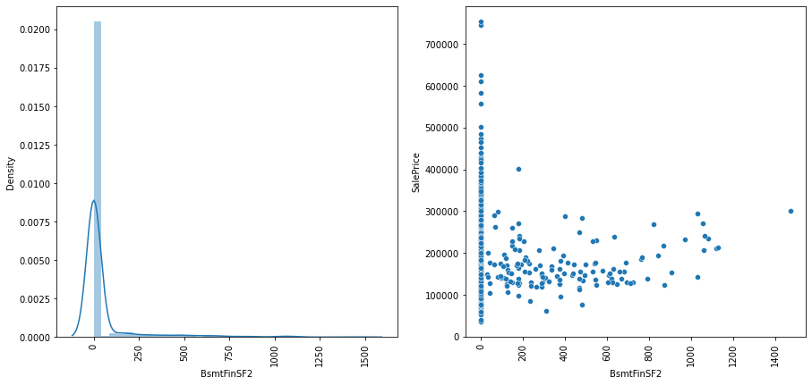
37. BsmtFinSF2
Checked unique values of the column.
There was no null value present in the column.
From visualization we concluded that data is showing somewhat positive skewness with data having highest density at around 0 & we cannot determine correlation of data with SalePrice on plot.

Slide 41
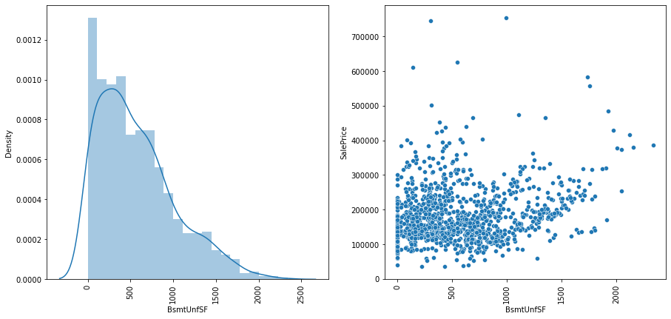
38. BsmtUnfSF
Checked unique values of the column.
There was no null value present in the column.
From visualization we conclude that data is showing positive skewness with having highest density at around 0 & data is having somewhat positive correlation with SalePrice on plot.

Slide 42
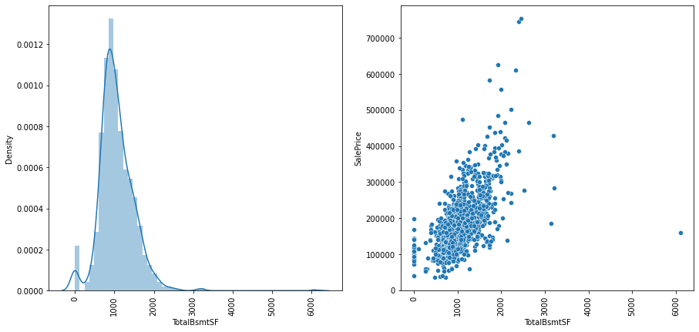
39. TotalBsmtSF
Checked unique values of the column.
There was no null value present in the column.
From visualization we conclude that data is showing positive skewness with having highest density at around 1000 & it is showing positive correlation with SalePrice on plot.

Slide 43
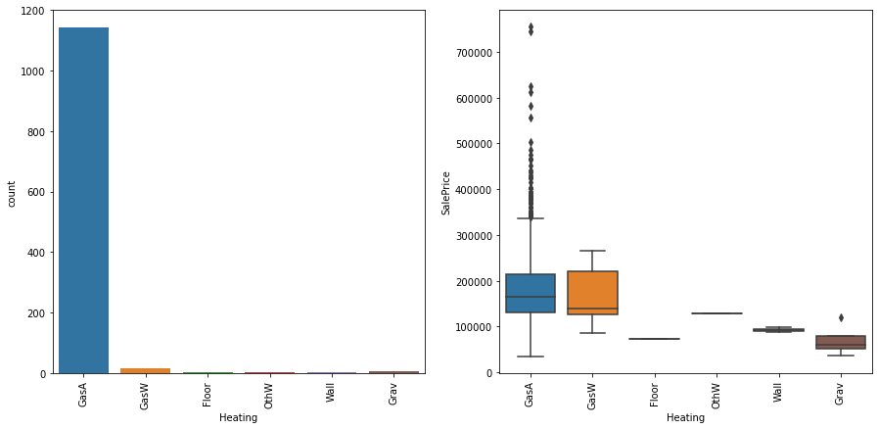
40. Heating
Checked unique values of the column.
There was no null value present in the column.
From visualization we conclude that most data is present in GasA category of Heating & outliers of SalePrice are present in only 2 categories out of total 6 categories of Heating.

Slide 44
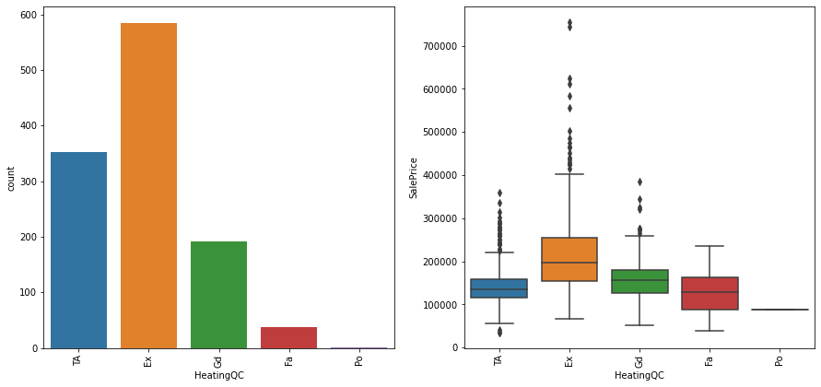
41. HeatingQC
Checked unique values of the column.
There was no null value present in the column.
From visualization we concluded that most data is present in Ex category of HeatingQC & outliers of SalePrice are present in 3 categories out of total 5 categories of HeatingQC.

Slide 45
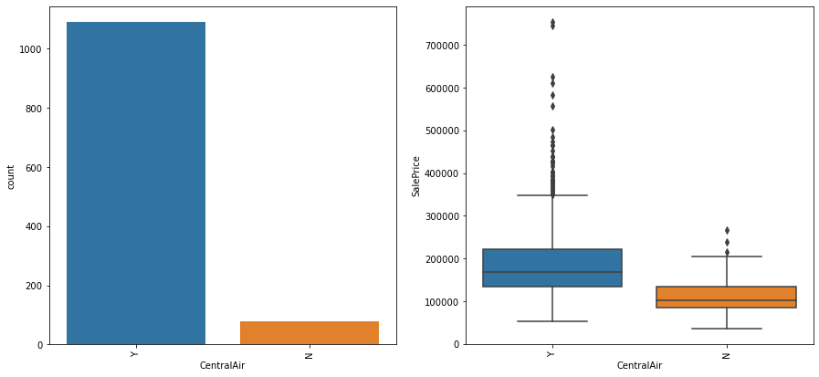
42. CentralAir
Checked unique values of the column.
There was no null value present in the column.
From visualization we concluded that most data is present in Y category of CentralAir & outliers of SalePrice are present in both categories of CentralAir.

Slide 46
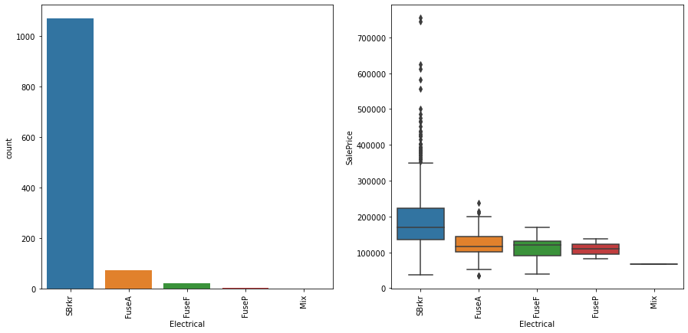
43. Electrical
Checked unique values of the column.
There was no null value present in the column.
From visualization we concluded that most data is present in SBrkr category of Electrical & outliers of SalePrice are present in 2 categories out of total 5 categories of Electrical.

Slide 47
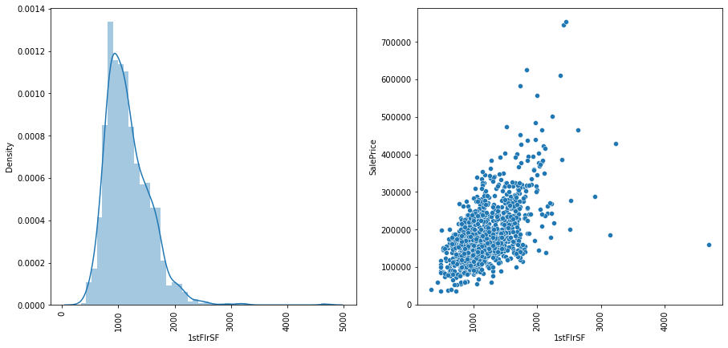
44. 1stFlrSF
Checked unique values of the column.
There was no null value present in the column.
From visualization we concluded that data is positively skewed with having highest density at around 600 & data is showing positive correlation with SalePrice on plot.

Slide 48
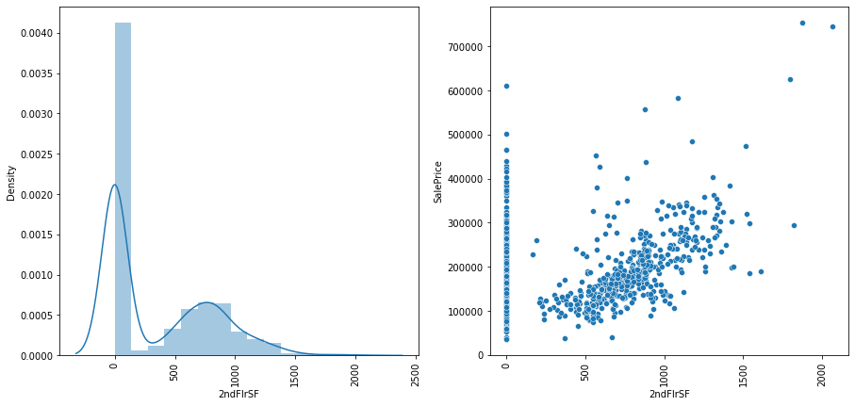
45. 2ndFlrSF
Checked unique values of the column.
There was no null value present in the column.
From visualization we concluded that data is showing somewhat positive skewness with multiple peaks & data having highest density at around 0. Also data is positively correlated with SalePrice on plot.

Slide 49
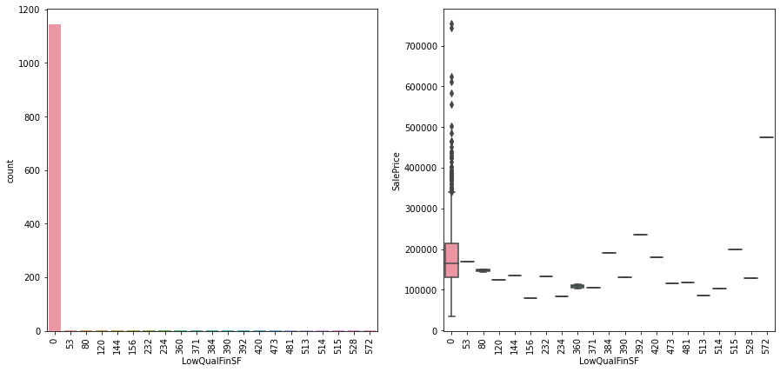
46. LowQualFinSF
Checked unique values of the column.
There was no null value present in the column.
From visualization we concluded that most data is present in 0 category of LowQualFinSF & outliers of SalePrice are present in only 1 category out of total 21 categories of LowQualFinSF.

Slide 50
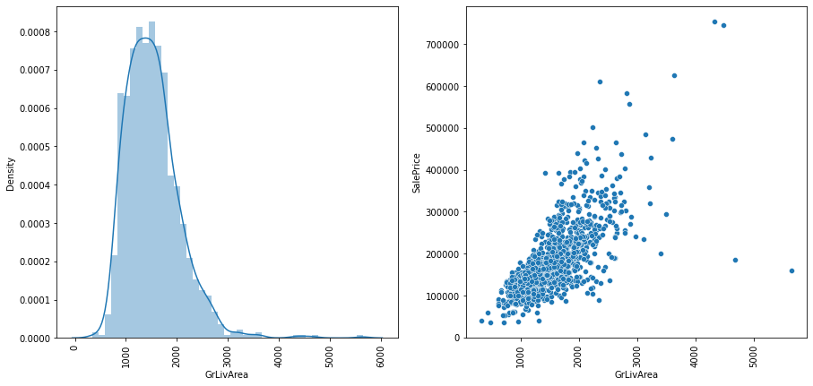
47. GrLivArea
Checked unique values of the column.
There was no null value present in the column.
From visualization we conclude that data is positively skewed with having highest density at around 1800 & it is showing positive correlation with SalePrice on plot.

Slide 51
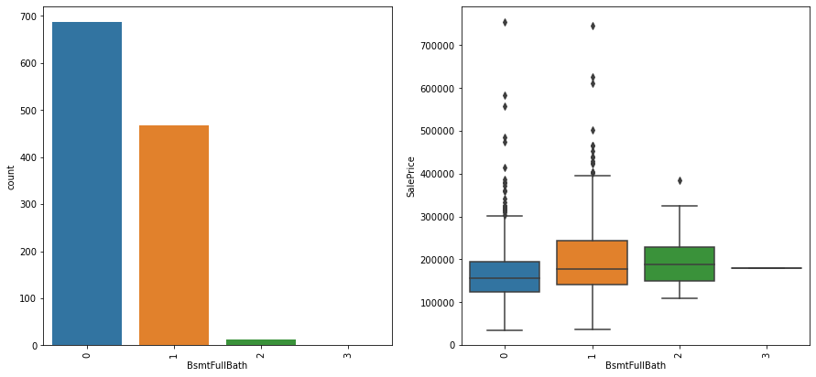
48. BsmtFullBath
Checked unique values of the column.
There was no null value present in the column.
From visualization we concluded that most data is present in 0 category of BsmtFullBath & outliers of SalePrice are present in 3 categories out of total 4 categories of BsmtFullBath.

Slide 52
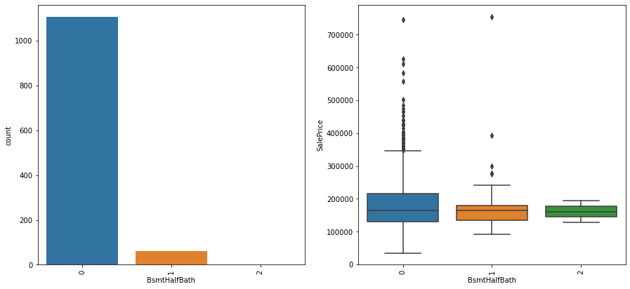
49. BsmtHalfBath
Checked unique values of the column.
There was no null value present in the column.
From visualization we conclude that most data is present in 0 category of BsmtHalfBath & outliers of SalePrice are present in 2 categories out of total 3 categories of BsmtHalfBath.

Slide 53
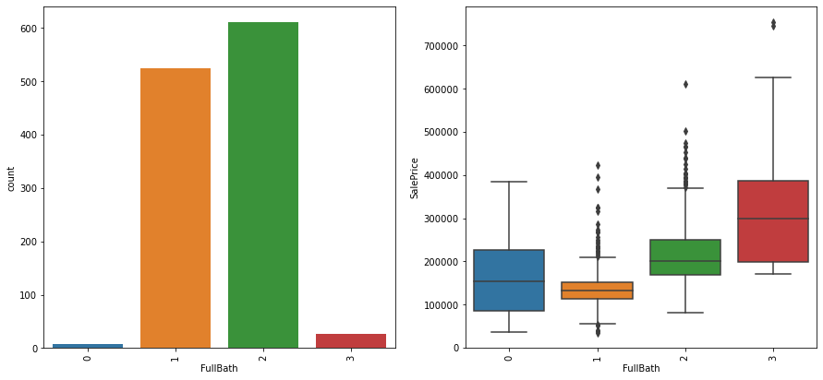
50. FullBath
Checked unique values of the column.
There was no null value present in the column.
From visualization we concluded that most data is present in category 2 of FullBath & outliers of SalePrice are present in 3 categories out of total 4 categories of FullBath.

Slide 54

51. HalfBath
Checked unique values of the column.
There was no null value present in the column.
From visualization we concluded that most data is present in category 0 of HalfBath & outliers of SalePrice are present in 2 categories out of total 3 categories of HalfBath.

Slide 55

52. BedroomAbvGr
Checked unique values of the column.
There was no null value present in the column.
From visualization we concluded that most data is present in category 3 of BedroomAbvGr & outliers of SalePrice are present in 4 categories out of total 8 categories of BedroomAbvGr.

Slide 56

53. KitchenAbvGr
Checked unique values of the column.
There was no null value present in the column.
From visualization we concluded that most data is present in category 1 of KitchenAbvGr & outliers of SalePrice are present in 2 categories out of total 4 categories of KitchenAbvGr.

Slide 57

54. KitchenQual
Checked unique values of the column.
There was no null value present in the column.
From visualization we conclude that most data is present in TA category of KitchenQual & outliers of SalePrice are present in 3 categories out of total 4 categories of KitchenQual.

Slide 58

55. TotRmsAbvGr
Checked unique values of the column.
There was no null value present in the column.
From visualization we concluded that most data is present in category 6 of TotRmsAbvGr & outliers of SalePrice are present in 8 categories out of total 12 categories of TotRmsAbvGr.

Slide 59

56. Functional
Checked unique values of the column.
There was no null value present in the column.
From visualization we conclude that most data is present in category Typ of Functional & outliers of SalePrice are present in 4 categories out of total 7 categories of Functional.

Slide 60

57. Fireplaces
Checked unique values of the column.
There was no null value present in the column.
From visualization we conclude that most data is present in category 0 of Fireplaces & outliers of SalePrice are present in 3 categories out of total 4 categories of Fireplaces.

Slide 61

58. FireplaceQu
Checked unique values of the column.
There was no null value present in the column.
From visualization we conclude that most data is present Gd category of FireplaceQu & outliers of SalePrice are present in every category of FireplaceQu.

Slide 62

59. GarageType
Checked unique values of the column.
Filled null values randomly to avoid data bias.
From visualization we conclude that data is mostly present in Attchd category of GarageType & outliers of SalePrice are present in every category of GarageType.

Slide 63

60. GarageYrBlt
Checked unique values of the column.
Filled null values randomly to avoid data bias.
From visualization we conclude that data is negatively skewed with having highest density at around 2010 & data is showing somewhat positive correlation with SalePrice & data is dispersed all over the place on plot.

Slide 64

61. GarageFinish
Checked unique values of the column.
Filled null values randomly to avoid data bias.
From visualization we conclude that most data is present in Unf category of GarageFinish & outliers of SalePrice are present in every category of GarageFinish.

Slide 65

62. GarageCars
Checked unique values of the column.
There was no null value present in the column.
From visualization we conclude that most data is present in category 2 of GarageCars & outliers of SalePrice are present in 4 categories out of total 5 categories of GarageCars.

Slide 66

63. GarageArea
Checked unique values of the column.
There was no null value present in the column.
From visualization we conclude that data is positively skewed with having highest density around 350 & data is showing positive correlation with SalePrice in plot.

Slide 67

64. GarageQual
Checked unique values of the column.
Filled null values randomly to avoid data bias.
From visualization we conclude that most data is present in category TA of GarageQual & outliers of SalePrice are present in only 2 categories out of total 5 categories of GarageQual.

Slide 68

65. GarageCond
Checked unique values of the column.
Filled null values randomly to avoid data bias.
From visualization we conclude that most data is present in category TA of GarageCond & outliers of SalePrice are present in 3 categories out of total 5 categories of GarageCond.

Slide 69

66. PavedDrive
Checked unique values of the column.
There was no null value present in the column.
From visualization we conclude that most data is present in category Y of PavedDrive & outliers of SalePrice are present in 2 categories out of total 3 categories of PavedDrive.

Slide 70

67. WoodDeckSF
Checked unique values of the column.
There was no null value present in the column.
From visualization we conclude that data is positively skewed with multiple peaks & having highest density at around 0. Also data is having positive correlation with Saleprice in plot.

Slide 71

68. OpenPorchSF
Checked unique values of the column.
There was no null value present in the column.
From visualization we conclude that data is positively skewed with having highest density at around 0 & data having positive correlation with SalePrice in plot.

Slide 72

69. EnclosedPorch
Checked unique values of the column.
There was no null value present in the column.
From visualization we conclude that data is somewhat positively skewed with having highest density at around 0 & data is having positive correlation with SalePrice on plot.

Slide 73

70. 3SsnPorch
Checked unique values of the column.
There was no null value present in the column.
From visualization we conclude that most data is present in category 0 of 3SsnPorch & outliers of SalePrice are present in 1 category out of total 18 categories of 3SsnPorch.

Slide 74

71. ScreenPorch
Checked unique values of the column.
There was no null value present in the column.
From visualization we conclude that data is somewhat positively skewed with having highest density at around 0 & data is having positive correlation with SalePrice on plot.

Slide 75

72. PoolArea
Checked unique values of the column.
There was no null value present in the column.
From visualization we conclude that most data is present in category 0 of PoolArea & outliers of SalePrice are present in only 1 category out of total 8 categories of PoolArea.

Slide 76

73. PoolQC
Checked unique values of the column.
Filled null values randomly to avoid data bias.
From visualization we conclude that most data is present in category Fa of PoolQC & outliers of SalePrice are present in every category of PoolQC.

Slide 77

74. Fence
Checked unique values of the column.
Filled null values randomly to avoid data bias.
From visualization we conclude that most data is present in category MnPrv of Fence & outliers of SalePrice are present in every category of Fence.

Slide 78

75. MiscFeature
Checked unique values of the column.
Filled null values randomly to avoid data bias.
From visualization we conclude that most data is present in category Shed of MiscFeature & outliers of SalePrice are present in 3 categories out of total 4 categories of MiscFeature.

Slide 79

76. MiscVal
Checked unique values of the column.
There was no null value present in the column.
From visualization we conclude that most data is present in category 0 of MiscVal & outliers of SalePrice are present in 2 categories out of total 20 categories of MiscVal.

Slide 80

77. MoSold
Checked unique values of the column.
There was no null value present in the column.
From visualization we conclude that most data is present in category 6 of MoSold & outliers of SalePrice are present in 10 categories out of total 12 categories of MoSold.

Slide 81

78. YrSold
Checked unique values of the column.
There was no null value present in the column.
From visualization we conclude that most data is present in category 2007 of YrSold & outliers of SalePrice are present in every category of YrSold.

Slide 82

79. SaleType
Checked unique values of the column.
There was no null value present in the column.
From visualization we conclude that most data is present in category WD of SaleType & outliers of SalePrice are present in 4 categories out of total 9 categories of SaleType.

Slide 83

80. SaleCondition
Checked unique values of the column.
There was no null value present in the column.
From visualization we conclude that most data is present in Normal category of SaleCondition & outliers of SalePrice are present in 5 categories out of total 6 categories of SaleCondition.

Slide 84
Plotting Heatmap
Plotted heatmap to check correlation of every column with target column.
There are many columns that have positive correlation with target columns
We dropped following ( Utilities, SaleCondition, Alley, GarageQual) columns to reduce multicollinearity.

Slide 85
Preparing Test dataset & scaling both datasets
Checked presence of null values in test dataset.
Then filled the null values of every column randomly to avoid data bias.
Then we changed data types of every column to int or float data type.
After that we scaled both datasets to remove outliers if present in datasets.

Slide 86
Applying GridSearchCV
We chose 4 regression models (Linear Regression Model, Decision Tree Regression Model, Random Forest Regression Model & Bagging Regression Model) to check performance of them on dataset to find out best suited model for the dataset.
Then one by one we applied GridSearchCV on each model to find best hyper parameter tuning while model is working on the dataset.
After applying GridSearchCV on every model we conclude that out of all models Random Forest Regression Model is giving the best train accuracy score for the dataset which is 0.9110 with hyper parameter combination (max_depth : 5, min_samples_leaf : 1, min_samples_split : 2)

Slide 87
Applying Model on dataset
Chose Random Forest Regression Model & made it ready by tuning hyper parameter.
After tuning hyper parameter applied model on dataset to make prediction.
After making prediction we made dataframe showing the predicted value only as we don’t have target column in test dataset.
As we cannot apply any metrices because of the absence of target column in test dataset. So we saved the model & task was completed.

Slide 88
THE END

